Slide 1
Chapter 5 Analysis
Evan Myers, Matthew Williams, Ian Neer, Dakota Nations, Darius Fiaillo, Alec Cromer, Kevin Mitchell, Brisaac Johnson

Slide 2
5.4.12 Analysis Summary
Requirements Elicitation is highly iterative and incremental
Functionality is sketched and proposed to the client
Prototypes
Nonfunctional requirements
Clients adds requirements throughout process
Analysis must be orderly to manage the complexity of the information

Slide 3
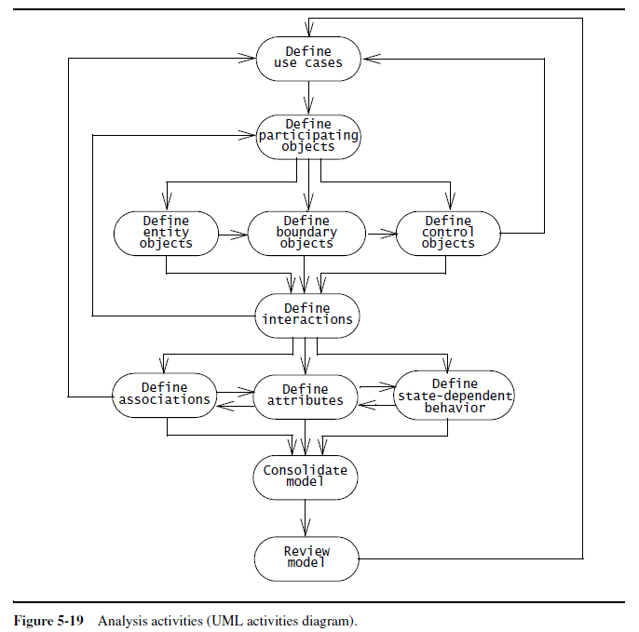
UML Activities Diagram

Slide 4
5.4.12 Analysis Summary
The users, developers, and client are involved in developing an initial use case model.
Identify concepts and build a glossary of participating objects
The developers classify the participating objects into entity, boundary, and control objects
Then the developers construct sequence diagrams to identify any missing objects
Definitions of associations, attributes, and state-dependent behavior
Use cases are then modified to account for any changes in functionality
Repeat process incrementally for new use cases.

Slide 5
5.4.12 Analysis Summary
Consolidate Model- the developers solidify the model by introducing qualifiers and generalization relationships and suppressing redundancies
Review Model- the client, users, and developers examine the model for correctness, consistency, completeness, and realism
The project schedule should plan for multiple reviews to ensure high-quality requirements and to provide opportunities to learn the requirements activity.
When most of the modifications are cosmetic, system design should proceed.

Slide 6
5.5 Managing Analysis
The primary challenge in managing the requirements in such a project is to maintain consistency while using so many resources.
The requirement analysis document describes a single coherent system understandable to single person

Slide 7
5.5.1 Documenting Analysis
Requirements Analysis Document (RAD)- documents requirements elicitation and analysis documents
RAD Section 3.5.3 (Object models)- documents in detail all the objects we identified, their attributes, and, when we used sequence diagrams, operations
Textual definitions
Relationships amongst objects
Documented with Class Diagrams
RAD Section 3.5.4 (Dynamic models)- documents the behavior of the object model in terms of state machine diagrams and sequence diagrams
Represent complex behaviors

Slide 8
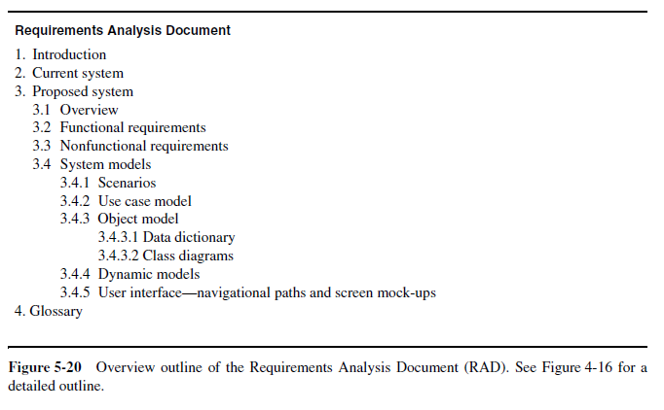
Requirements Analysis Document

Slide 9
5.5.5 Client Sign-Off

